Slide 1
Nail Salon Management System
(Deliverable 2: Analysis Phase)
Salman Khan, Hamza Mir, Thomas Zhang, Spencer Wilkins, Derek Luong, Asad Khan

Slide 2
Functional requirement
1.) Process Oriented
1.1.) Ability for Customers to book appointments with nail tech by name, pay for the service, and purchase gift cards directly on the website.
1.2.) Ability for customer appointment to be assigned to a technician, with the time of appointment and estimated time of appointment
1.3.) Creation of a link between the web app and the database. This will allow the customers to access this site and create an account that will offer certain benefits.
1.4.) Using transaction information creates a customer reward system that will keep track of customer reward points and spending.
1.5) Employee clock-in/clock-out option.
Calculates salary for employees.
1.6.) Generates a table for employee schedules that can be accessed by employees and edited by the owner.

Slide 3
Functional Requirement
2.) Information Oriented
2.1.) Able to organize customer information name, age, address, etc. and will be able to keep track of customer transactions along with warranty information.
2.2.) Specify details relating to the business such as opening/closing times and the business address.
2.3.) Store hours worked by an employee for any given day recorded from clock-in/clock-out.
2.4.) Displays schedules created by the owner for employees to view.
2.5.) The system must retain customer history for 3 years.
2.6.) Be able to track inventory (what was ordered and how much of it)

Slide 4
Nonfunctional Requirement
1.) Operational
1.1.) The system should be compatible with any web browser
1.2.) Should be able to run on android and iPhones
2.) Performance
2.1.) The system should be available for use 24 hours per day, 365 days per year
2.2.) The system should update within 10 minutes of a change.
2.3.) The system must support 150 users from 8:30 a.m–5 p.m.; 50 users at all other times

Slide 5
Nonfunctional Requirement
3.) Security
3.1.) Nail technicians/workers can only see their sales/assignments
3.2.) Only managers/owner can see each workers sales, assignments
3.3.) Only owner can approve new customization options
3.4.) Only the owner can edit and view employee schedules and payroll.
3.5.) System should have a firewall and all protection needed from viruses
3.6.) Customer account login is kept secure
3.7.) Employees have login IDs unique to them.
4.) Cultural and Political
4.1.) Company buys all technology from hp
4.2.) Personal information is protected under the Privacy Law

Slide 6
Interview
Interview was conducted with Ann Luong the owner, Emily Vu the nail technician, Khanh Luong the receptionist.
Interview was conducted on 10/16/2019 from 10am - 12pm

Slide 7
Interview Q/A
What your job responsibility?
What is your task at work?
How often do you use the current system?
Would you say the current system is competent enough to perform all necessary business tasks?
What are some features that need to be improved?
What new features would make performing your job easier?
What are some troubles that you encounter at work?
What solution do you think that can fix your trouble at work?

Slide 8
Observation As-in-System
The application is hosted by a very old server that takes up a lot of space while providing low benefit
The system is controlled by a mouse and keyboard, and the owner would prefer the new system to have a touch screen in order to save space.
The system freezes often so the application needs to be rebooted often which can take up to 10 minutes
Simple interface design
The application is only able to calculate the total and print receipt, lacks newer features

Slide 9
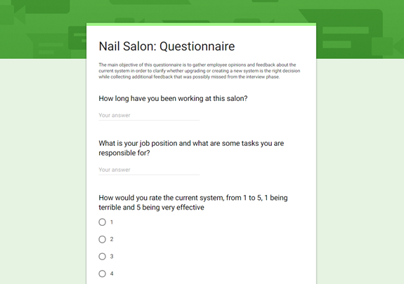
Questionnaire
Purpose: The main objective of this questionnaire is to gather employee opinions and feedback about the current system in order to clarify whether upgrading or creating a new system is the right decision while collecting additional feedback that was possibly missed from the interview phase. The questionnaire was responded by 8 nail technicians and 2 receptionist.
https://docs.google.com/forms/d/e/1FAIpQLSfZ4qHT1CiXQaSqXA_5UNuTm7NxH5IMUFJl0H1Jsi7IukErpw/viewform?vc=0&c=0&w=1

Slide 10
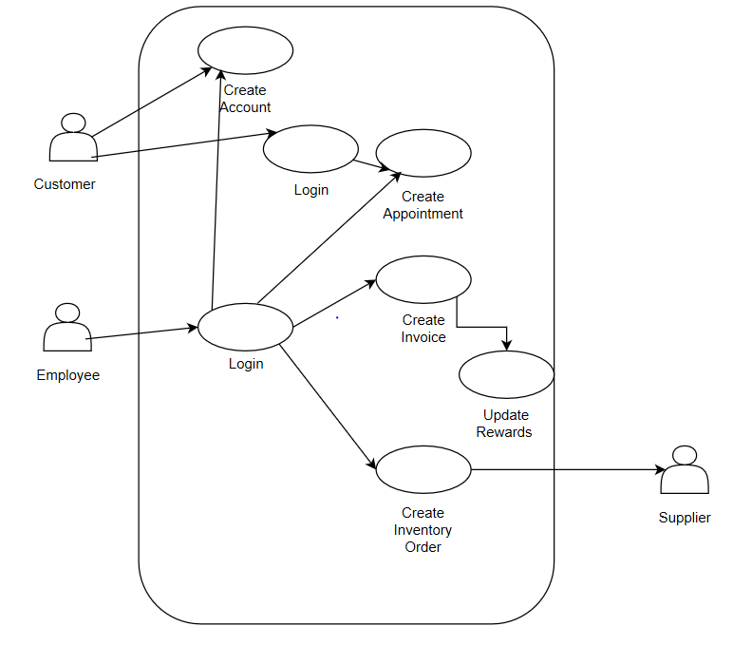
Use Case Diagram
4 Main Use Cases
Creation of a Customer’s Account
Creation of an Appointment
Create an Invoice
Create an Inventory Order

Slide 11
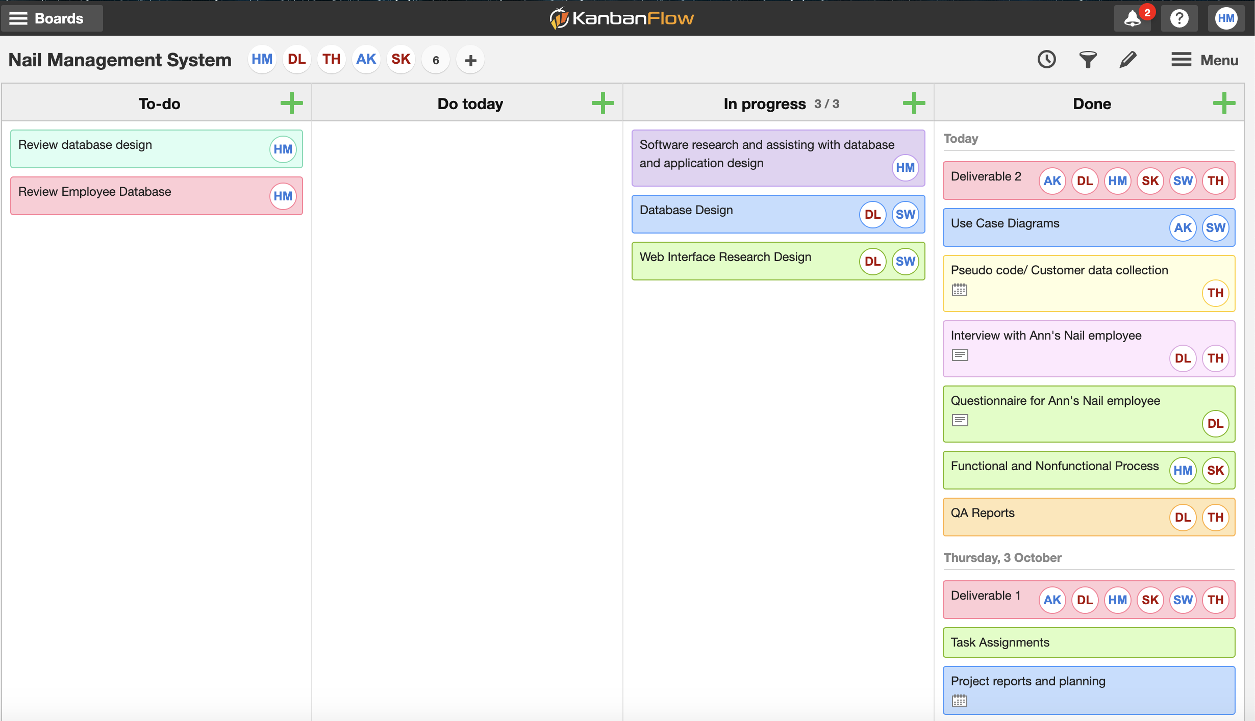
Kanban Tasks

